Slide 1
THE LINKED LIST DATA STRUCTURE

Slide 2
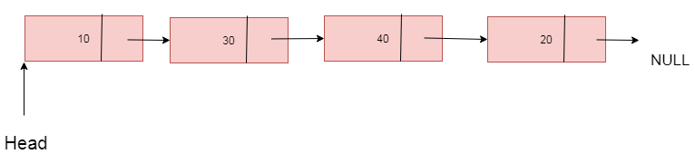
Overview
Linked list store a sequential collection of elements.
But unlike arrays, in Linked List, the elements are not place contiguously in memory.
Each element consists of a node that store the element itself and also a reference (also known as a point or link) that points to the next element.

Slide 3
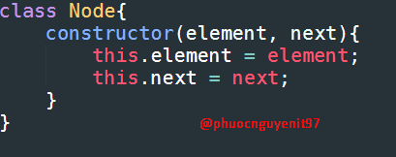
LinkedList Implement By Coding

Slide 4
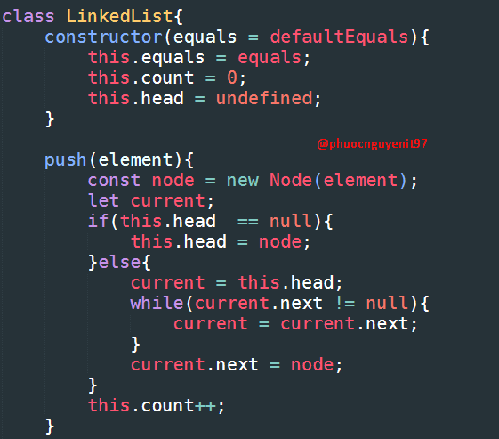

Slide 5
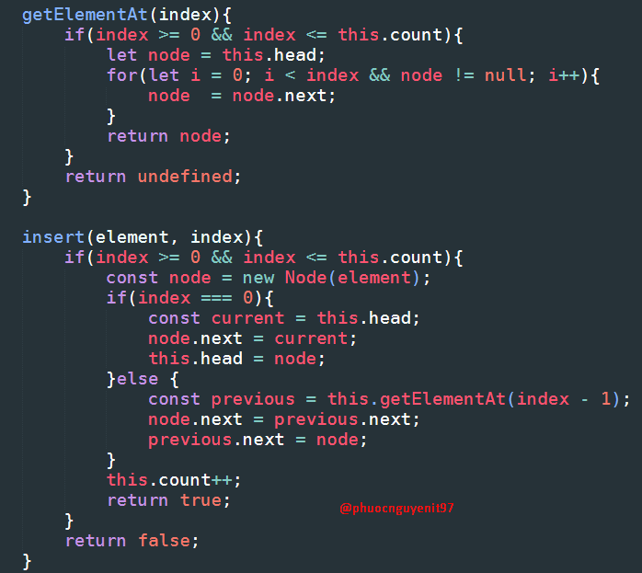

Slide 6
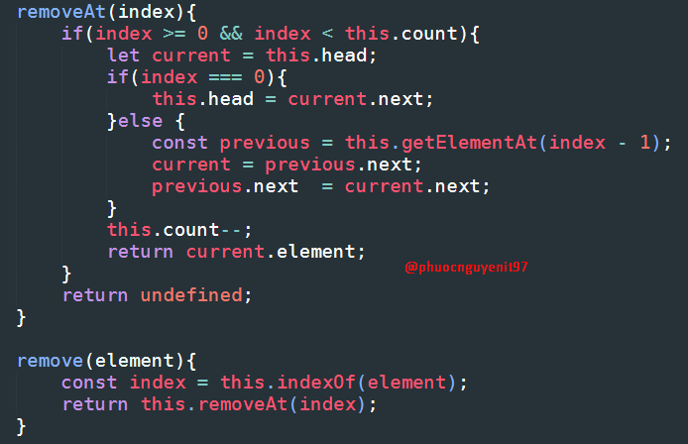

Slide 7
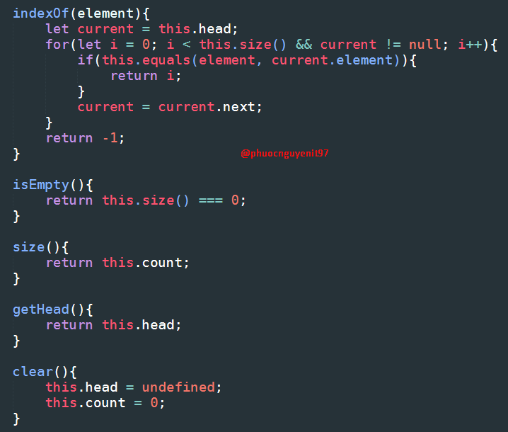

Slide 8
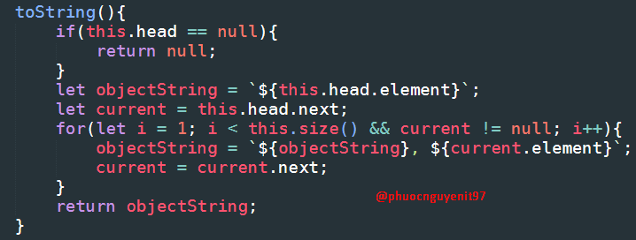

Slide 9
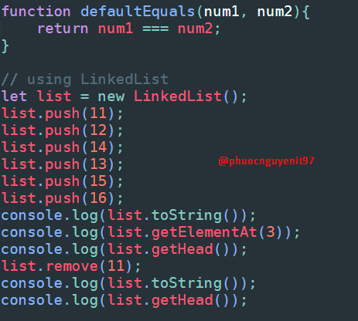
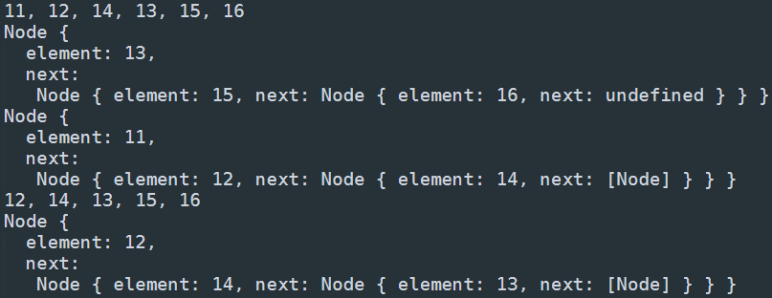
Using LinkedList

